Slide 1
Towards
True Cost Accounting of Agricultural Food Products
Notes:
Einheitliches Farbschema
Lukas sagt max. 3 Schriftgrößen
28: Folienüberschriften
24: Highlights/Überschriften
16: Text

Slide 2

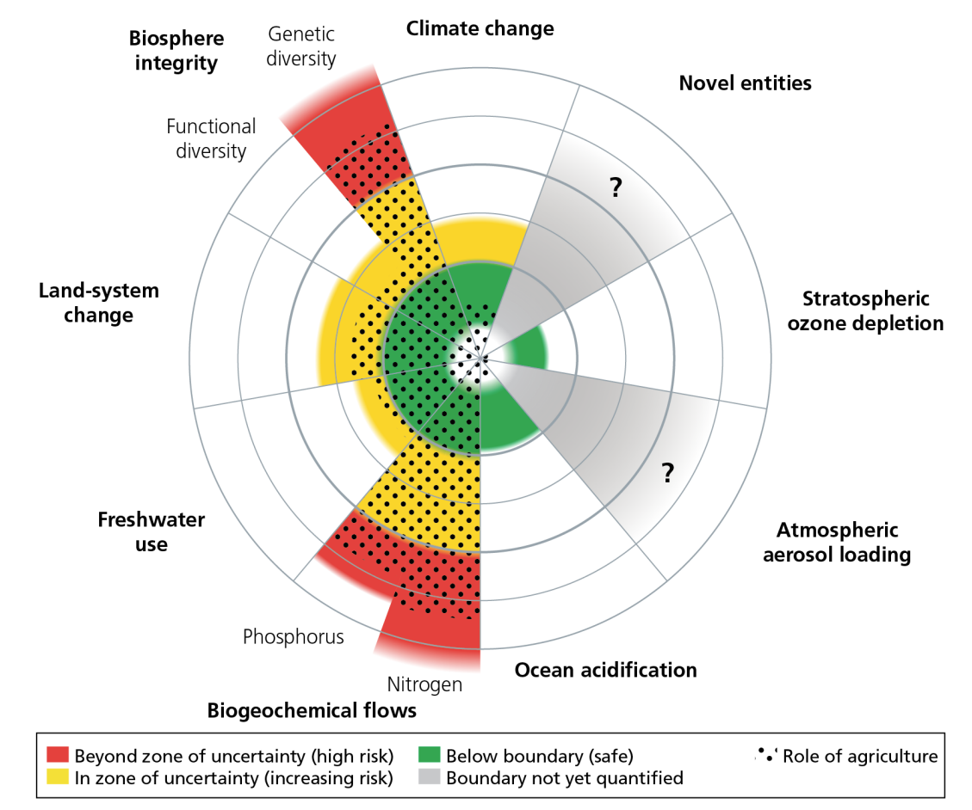
1. Motivation
Planetary boundaries
Agriculture:
major driver of Earth system exceeding planetary boundaries
Sector of high
environmental impact
Great potential for reducing plantetary pressure
Campbell et al. (2017) based on Steffen et al. (2015)
3
Notes:
Agriculture has been major driver of transgression of the two planetary boundaries „biochemical flows“ regarding both phosphorus and nitrogen, and „biosphere integrity“ in regards to Genetic diversity
Planetary boundaries based off Steffen et al. 2015
Datenbeispiele:
70% of global Freshwater is withdrawn for food production
Primary driver of deforestation
About 50% of agriculturally used nitrogen (in the form of fertilizers) is eventually lost as reactive nitrogen emissions to soil, air and water bodies
Beispiele nennen:
Nitrogen pollution → from fertilizer use
Land system change → LUC for feedstock

Slide 3








1. Motivation
Land-system change
LUC
„True Cost Accounting (TCA) is an economic assessment that does not just look at the usual financial metrics, but seeks to
understand the broader social and ecological impacts
of food systems […].“
– Baker et al. (2020)
Reforestation
Own figure, content based on Ott et al. (2006)
Biochemical flows (nitrogen)
Fertilization
Water purification
Own figure, content based on Sutton et al. (2011)
4

Slide 4
1. Motivation
Land-system change
Internalizing externalities
LUC
Price
Reforestation
Own figure, content based on Ott et al. (2006)
Biochemical flows (nitrogen)
Fertilization
Water purification
Quantity
Own figure, content based on Sutton et al. (2011)
Own figure, content based on Helbling (2010) and Sturm and Vogt (2011)
4
Notes:
Linker Teil plakativ und verständlich; ganz am Anfang; mit Motivation beginnen

Slide 5
1. Motivation
Land-system change
Land-system change
Internalizing externalities
LUC
Price
S u p p l y
Reforestation
Own figure, content based on Ott et al. (2006)
Biochemical flows (nitrogen)
p
Fertilization
D e m a n d
Water purification
Quantity
Own figure, content based on Sutton et al. (2011)
q
Own figure, content based on IMF (2010) and Sturm and Vogt (2011)
4

Slide 6

1. Motivation
Land-system change
Internalizing externalities
LUC
Price
Reforestation
Own figure, content based on Ott et al. (2006)
p*
Biochemical flows (nitrogen)
p
Fertilization
Water purification
Quantity
Own figure, content based on Sutton et al. (2011)
q*
q
4
Notes:
Polluter Pays Principle
Diss. Beschäftigt sich v.a. mit dem Preisdelta, Ausblick sollte sich v.a. mit Mengenänderungen, Produktwechseln und ökol. Implikationen aufgrund der Marktverschiebungen beschäftigen

Slide 7
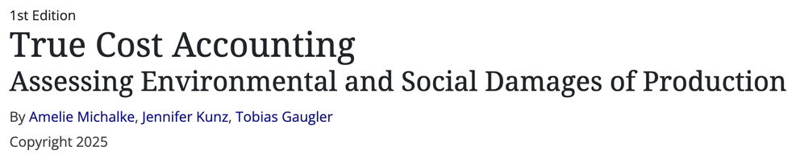

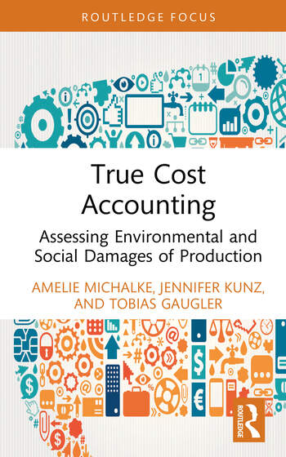


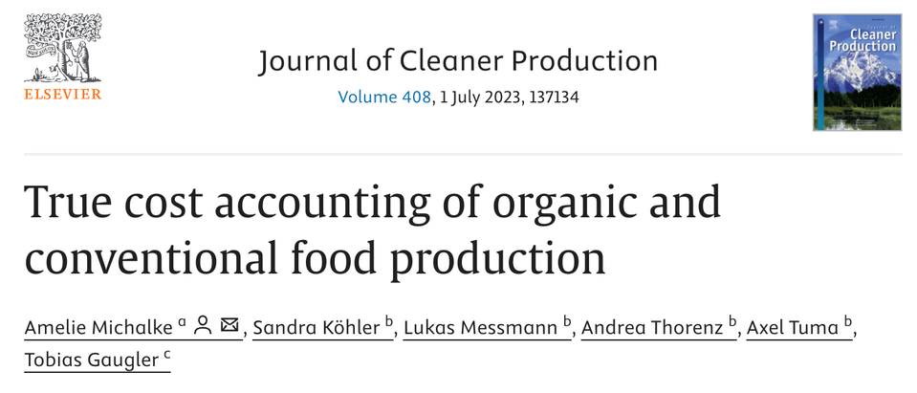
2. TCA in Science
4
Notes:
Polluter Pays Principle
Diss. Beschäftigt sich v.a. mit dem Preisdelta, Ausblick sollte sich v.a. mit Mengenänderungen, Produktwechseln und ökol. Implikationen aufgrund der Marktverschiebungen beschäftigen

Slide 8
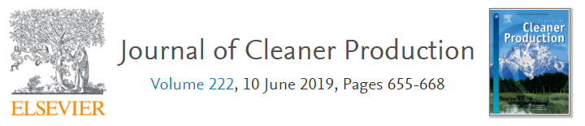
2. TCA Calculation
Hybrid LCA & TCA framework to detect market distortions
Food production
True Cost Accounting of organic and conventional food production
Michalke, Köhler, Messmann, Thorenz, Tuma, Gaugler
Case study
Different agricultural practices
Different food products
A) Environmental impacts
Life Cycle Assessment (LCA)
Monetizing environmental impact
B) Economic evaluation
True Cost Accounting (TCA)
Effects on market prices
C) Market effects
True prices and price distortions
Based on Figure 1, Michalke et al. (2023)
7
Notes:
Eigenleistung herausarbeiten
9min

Slide 9
2. TCA Calculation – 2.1 Methods
1. Goal and scope definition
2. Life Cycle Inventory
3. Life Cycle Impact Assessment
T C A
Definition of
  system boundaries
  assumptions
  functional unit
Modeling
Aggregated
inputs & outputs
Charac-
terization
Impact categories
Monetization of midpoints and aggregating to total external costs of food
Diesel
…
Ozone depletion
Inputs
Water
…
Ionizing radiation
Cradle
Seeds
…
Photochem. ozone formation
Nutrients
…
…
Particulate matter formation
Process A
Process B
...
…
Human toxicity
64 kg CO₂
Climate change
× 0.20 €/kg CO₂ eq
…
× 1
Own figure, content based on Huijbregts et al. (2016), ISO 14040/14044, Michalke et al. (2023)
1 FU
0.15 kg CH₄
Natural land transformation
…
× 36
0.43 kg N₂O
197 kg CO₂ eq
Water depletion
Process C
…
× 298
Total external costs
…
Terrestrial acidification
Wastewater
…
…
Freshwater eutrophication
Biogas
…
Marine eutrophication
Process D
…
Terrestrial ecotoxicity
Emissions
…
Freshwater ecotoxicity
Wastes
…
Marine ecotoxicity
Gate
…
Land occupation
…
Metal depletion
Product
Co-product
…
…
Fossil depletion
8
Notes:
Mehr Zeit hier verwenden, besser abholen LCA, Einordnung in Forschungskontext
Beispielzahlen etwas abkürzen
TCA wegziehen und nur LCA betrachten, TCA gesondert und extra beschreiben mit Literatur usw.
Ganz exemplarische, einfache LCA System als Grafik; nicht unbedingt gelb

Slide 10
2. TCA Calculation – 2.1 Methods
Environmental costing
TCA in the food context
UN Food Systems summit (2021):
negative externalities of the global food system = $19.8 trillion
Food and Land use Coalition (2019):
global food system‘s hidden annual costs
= $12 trillion
Sustainable Food Trust (2019):
UK: for every £ spent for food, another £ is spent on environmental or health costs
Rockefeller Foundation (2021):
US: external costs of food triple current expenditure for food
Impact monetization
Abatement cost
  Cost of reduction or prevention
  Support decision-making: displays costs for certain measures or targets
  Example:
  Using renewable energy sources instead of fossil
Damage cost
  Cost due to damage
  Measure effects of inaction or failure to achieve certain targets
  Example:
  Restoring ecosystem to its original state
9
Notes:
Ab 15 min

Slide 11
2. TCA Calculation – 2.2 Scenarios
Scenarios of production
Exemplary production system
Literature parameter
EU-reg. parameter
LCA of 22 products: System boundaries:
17 plants-based cradle to farmgate
5 animal-based
LCIA method: Functional unit:
ReCiPe 2016 1 kg of product
LCA base-data:
Agrifootprint 5.0 (re)modelled in SimaPro
Arable crop production
Process remodel
Animal production systems
Farmgate
Pig & poultry manure
Inputs
Crop cultivation
Seeds
Co-products
Fertilizers
Straw
Based on Table 1, Michalke et al. (2023)
Pesticides
Production scenarios
# | Base cases
C | Conventional base case
O | Organic base case
# | Scenario analyses
O1 | yield (O) − standard deviation
O2 | yield (O) + standard deviation
O3 | manure (C)
O4 | manure (literature)
Energy carriers
Product
Cereals
Irrigation water
Yield
Roots
Capital goods
Beets
Buildings
Legumes
Machinery
Oilseeds
Own figure based on Michalke et al. (2023)
10
Notes:
Start bei 19 min
Auswahl der Produkte?
Arrows of solid lines describe transportation processes
Arrows of dashed lines describe substance transfers with no particular transport involved
Everything in black is taken from database AFP5.0

Slide 12
2. TCA Calculation – 2.2 Scenarios
Yield differentiation: Plant-based products
average
mean
Defining yield scenarios to depict the variability of agricultural production
L
Own figure based on Michalke et al. (2023)
11
Notes:
Plant: 52 Datenpunkte aus 25 vers. Studien
Bold: superordinate product groups
Wann nimmt man mean, wann average??

Slide 13
2. TCA Calculation – 2.2 Scenarios
Scenarios of costing
Based on Table 1, Michalke et al. (2023)
Based on Table S1-2, Michalke et al. (2023)
Costing scenarios
# | Base case
EPH | Environmental Prices Handbook
# | Scenario analyses
EPH, l | lower bound of EPH
EPH, u | upper bound of EPH
TPF | True Prices Foundation
Impact categories | unit | EPH [€]
Climate change | kg CO₂ eq | 0.20
Ozone depletion | kg CFC-11 eq | 30.40
Ionizing radiation | kBq U235 eq | 0.05
Photochemical oxidant formation | kg NMVOC | 1.15
Particulate matter formation | kg PM10 eq | 39.20
Terrestrial acidification | kg SO₂ eq | 4.97
Freshwater eutrophication | kg P eq | 1.86
Marine eutrophication | kg N eq | 3.11
Terrestrial ecotoxicity | kg 1,4-DB eq | 8.69
Freshwater ecotoxicity | kg 1,4-DB eq | 0.04
Marine ecotoxicity | kg 1,4-DB eq | 0.01
Human toxicity | kg 1,4-DB eq | 0.10
Land occupation | m²a | 0.0845
Natural land transformation | m²
Metal depletion | kg Fe eq
Fossil depletion | kg oil eq
Water depletion | m³
In combination with production scenarios we derive 26 datasets of scenario analyses
12
Notes:
25 min
Vorbereiten auf Unsicherheitsfragen; was sollte passieren, um Unsicherheiten zu reduzieren?
For example for land transformation, we dove deeper in the costing sceme in contribution C. However, a combination of these methods was not yet achieved in Contribution D.

Slide 14
Cost factors with adaptations
Midpoint | unit | E [€] ^{[1]} | E1 [€] ^{[2]} | E2 [€] ^{[3]} | E3[€] ^{[4]}
Climate change | kg CO₂ eq | 0.20 | 0.06 | 0.37 | 0.15
Ozone depletion | kg CFC-11 eq | 30.40 | 22.10 | 45.70 | 31.80
Ionizing radiation | kBq U235 eq | 0.05 | 0.03 | 0.06 | ^{[5]}
Photochemical oxidant formation | kg NMVOC | 1.15 | 0.84 | 1.84 | 2.22
Particulate matter formation | kg PM10 eq | 39.20 | 28.00 | 60.40 | 31.64 ^{[5]}
Terrestrial acidification | kg SO₂ eq | 4.97 | 0.53 | 5.66 | 3.36
Freshwater eutrophication | kg P eq | 1.86 | 0.25 | 2.11 | 304.00
Marine eutrophication | kg N eq | 3.11 | 3.11 | 3.11 | 63.40
Terrestrial ecotoxicity | kg 1,4-DB eq | 8.69 | 1.17 | 9.85 | 7.27
Freshwater ecotoxicity | kg 1,4-DB eq | 0.04 | 0.00 | 0.04 | 0.03
Marine ecotoxicity | kg 1,4-DB eq | 0.01 | 0.00 | 0.01 | 0.01
Human toxicity | kg 1,4-DB eq | 0.10 | 0.07 | 0.15 | 0.038 ^{[6]}
Land occupation | m²a | 0.0845 | 0.0255 | 0.6850 | 0.2390 ^{[7]}
Natural land transformation | m² | ^{[9]} | ^{[9]} | ^{[9]} | 0.0223 ^{[7]}
Metal depletion | kg Fe eq | ^{[9]} | ^{[9]} | ^{[9]} | 0.005 ^{[8]}
Fossil depletion | kg oil eq | ^{[9]} | ^{[9]} | ^{[9]} | 0.437
Water depletion | m³ | ^{[9]} | ^{[9]} | ^{[9]} | 1.27
Table S1-3: Cost factors
[1] E: For global warming the price factor is derived from Umweltbundesamt (2020), for all other midpoints the average values from the Environmental Prices Handbook (EPH) are taken (de Bruyn et al., 2018).
[2] E1: For global warming the price factor is derived from the average values from the EPH, the German consumer price index of the Federal Statistical Office was used for price adjustment from 2015 to 2020 (Statistisches Bundesamt (Destatis), 2021). For all other midpoints the lower bound values from the EPH are taken (de Bruyn et al., 2018).
[3] E2: For global warming the price factor is derived from Ricke et al. (2018), exchange rates of the European Central Bank were used to for currency conversion from USD to EUR (ECB, 2021). For all other midpoints the upper bound values from the EPH are taken (de Bruyn et al., 2018).
[4] E3: All price factors are derived from the True Pricing foundation (Galgani et al., 2020).
[5] The TPF documentation gives a cost factor of €46.20 per kg PM2.5 eq. To convert from PM2.5 to PM10, a characterization factor of 0.68 (de Bruyn et al., 2018) was used.
[6] The TPF documentation gives a cost factor of €54,800 per DALY. To convert from DALY to kg 1,4-DB eq, the ReCiPe 2008 midpoint-to-endpoint factor of 7∙10⁻⁷ was used.
[7] Grassland
[8] The TPF documentation gives a cost factor of €0.223 per kg Cu eq. To convert from Cu to Fe, the ReCiPe 2008 characterization factor of 42.7 kg Fe eq. per kg Cu eq. was used.
[9] No price factor available, which makes the monetized evaluation a conservative estimate.

Slide 15
2. TCA Calculation – 2.3 Results
Market prices plus externalities of plant-based products
Market price organic EPH EPH, lower bound
+
Market price conventional EPH, upper bound TPF
“True” costs of Oat
 |  | conventional | organic
Market price |  | 0.19 € | 0.38 €
EPH |  | 0.51 € | 0.23 €
 | true price | 0.70 € | 0.61 €
EPH, lower |  | 0.35 € | 0.46 €
 | true price | 0.54 € | 0.84 €
EPH, upper |  | 1.98 € | 1.81 €
 | true price | 2.17 € | 2.19 €
TPF |  | 1.55 € | 1.09 €
 | true price | 1.74 € | 1.47 €
Oat
Based on Figure 5, Michalke et al. (2023)
13
Notes:
Fertig 30 min
Data of market prices:
Oats and Suflower seeds → reversal of market prices in favor of organic produce
Zu 3. Especially when looking at all scenario combinations it becomes clear how farming practice has less impact on result variability compared to costing method
Grafiken übereinanderlegen und einzeln aufbauen ODER einzelne Balken rausgreifen (oder gemischt)

Slide 16
2. TCA Calculation – 2.3 Results
Market prices plus externalities of plant-based products
Figure 5, Michalke et al. (2023)
Market price organic EPH EPH, lower bound
+
Findings
General alignment of price level observable in cereals (i.a.)
Other products: gap in market prices reduces
Results vary drastically depending on the used costing method
Market price conventional EPH, upper bound TPF
€
€
14
Notes:
Data of market prices:
Oats and Suflower seeds → reversal of market prices in favor of organic produce
Positive impacts of agricultural production are not yet internalized with this method

Slide 17
2. TCA Calculation – 2.3 Results
Market prices plus externalities of animal-based products
Figure 6, Michalke et al. (2023)
Market price organic EPH EPH, lower bound
+
Findings
General alignment of price level observable in cereals (i.a.)
Other products: gap in market prices reduces
Results vary drastically depending on the used costing method
Market price gap closes on average by about from avg. 70% to avg. 30%
Relative surcharge over all categories highest for beef (+265% for conventional beef cattle)
Market price conventional EPH, upper bound TPF
15
Notes:
Data of market prices:
Oats and Suflower seeds → reversal of market prices in favor of organic produce
Zu 3. Especially when looking at all scenario combinations it becomes clear how farming practice has less impact on result variability compared to costing method

Slide 18
Process contribution wheat

Slide 19
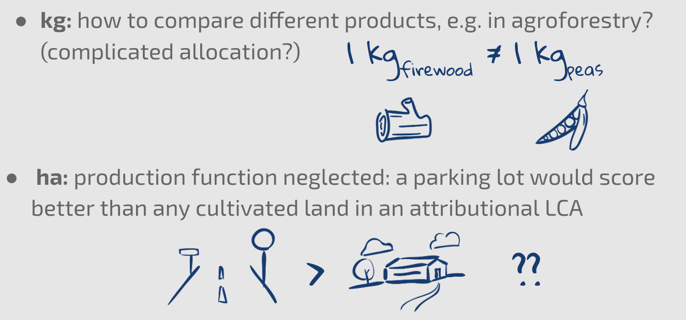
3. Further Research – Functional Units
The problem with ha and kg
15
Notes:
Data of market prices:
Oats and Suflower seeds → reversal of market prices in favor of organic produce
Zu 3. Especially when looking at all scenario combinations it becomes clear how farming practice has less impact on result variability compared to costing method

Slide 20
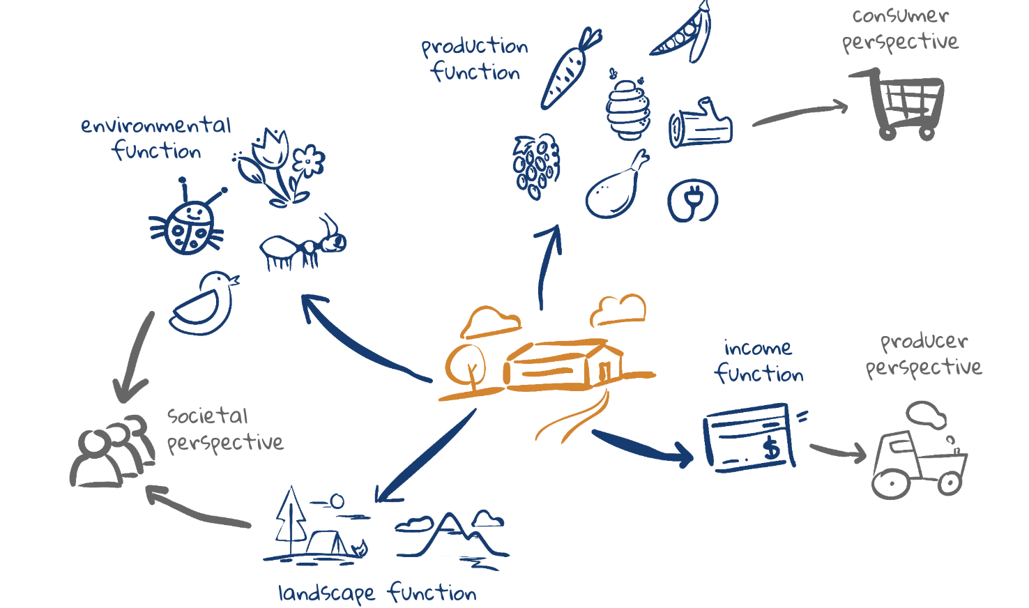
3. Further Research – Functional Units
Different perspectives – different units
15
Notes:
Data of market prices:
Oats and Suflower seeds → reversal of market prices in favor of organic produce
Zu 3. Especially when looking at all scenario combinations it becomes clear how farming practice has less impact on result variability compared to costing method

Slide 21
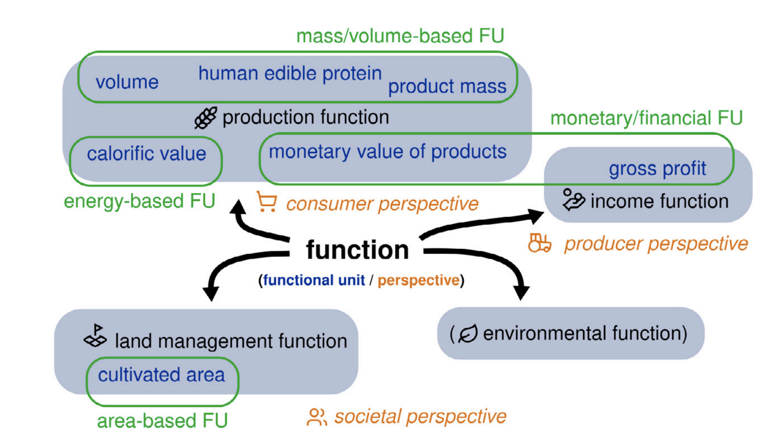
3. Further Research – Functional Units
Stakeholder-based taxonomy of functions
15
Notes:
Data of market prices:
Oats and Suflower seeds → reversal of market prices in favor of organic produce
Zu 3. Especially when looking at all scenario combinations it becomes clear how farming practice has less impact on result variability compared to costing method

Slide 22
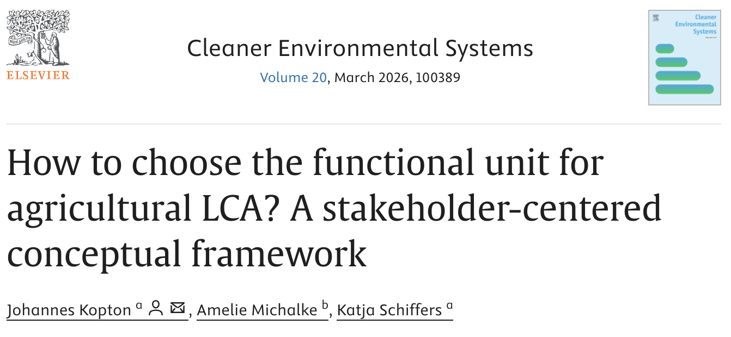
3. Further Research – Functional Units
15
Notes:
Data of market prices:
Oats and Suflower seeds → reversal of market prices in favor of organic produce
Zu 3. Especially when looking at all scenario combinations it becomes clear how farming practice has less impact on result variability compared to costing method

Slide 23
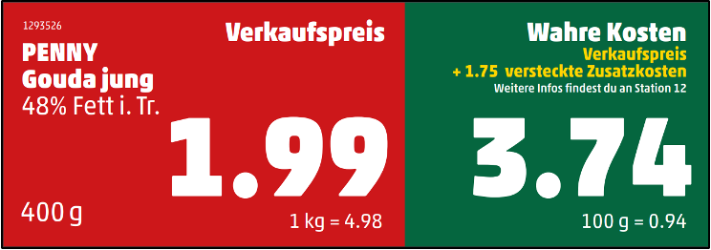


4. TCA in Practice – The Penny Campaign
PENNY Campaign 2020
PENNY Campaign 2023
17
Notes:
Ab 32 min

Slide 24


4. TCA in Practice – The Penny Campaign
  One week
  All German Penny markets
  9 products
  Donations: 375.000€
  Questionnaire before and after campaign (N=2.000)
17
Notes:
Ab 32 min

Slide 25
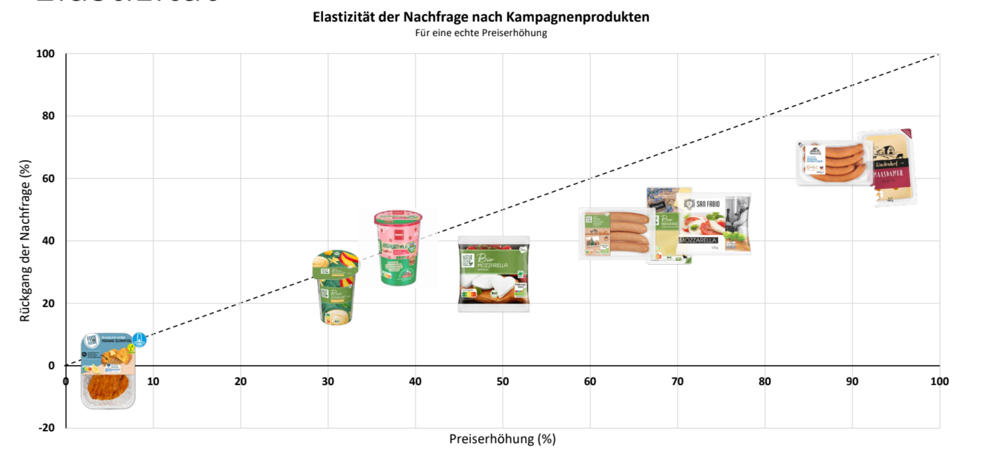
4. TCA in Practice – The Penny Campaign
17
Notes:
Ab 32 min

Slide 26
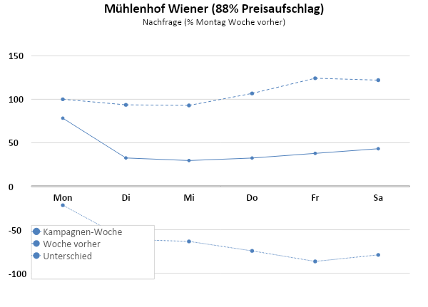
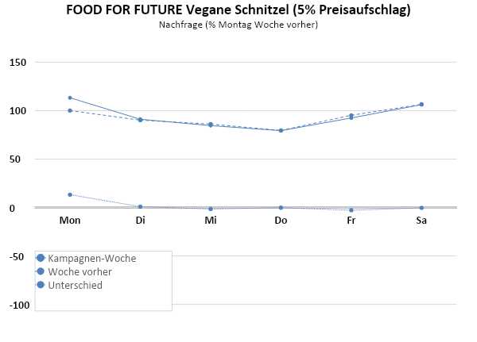


4. TCA in Practice – The Penny Campaign
17
Notes:
Ab 32 min

Slide 27
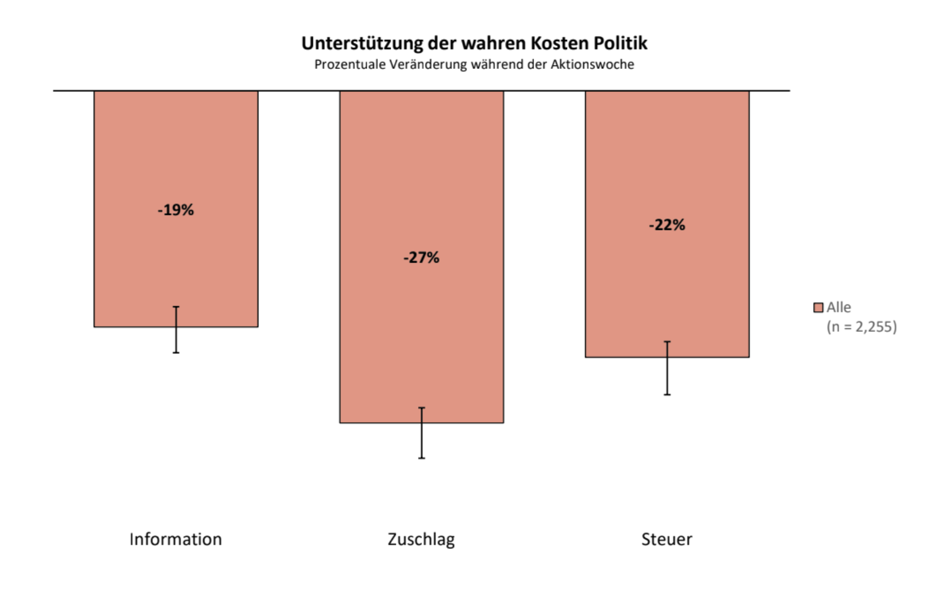
4. TCA in Practice – The Penny Campaign
17
Notes:
Ab 32 min

Slide 28
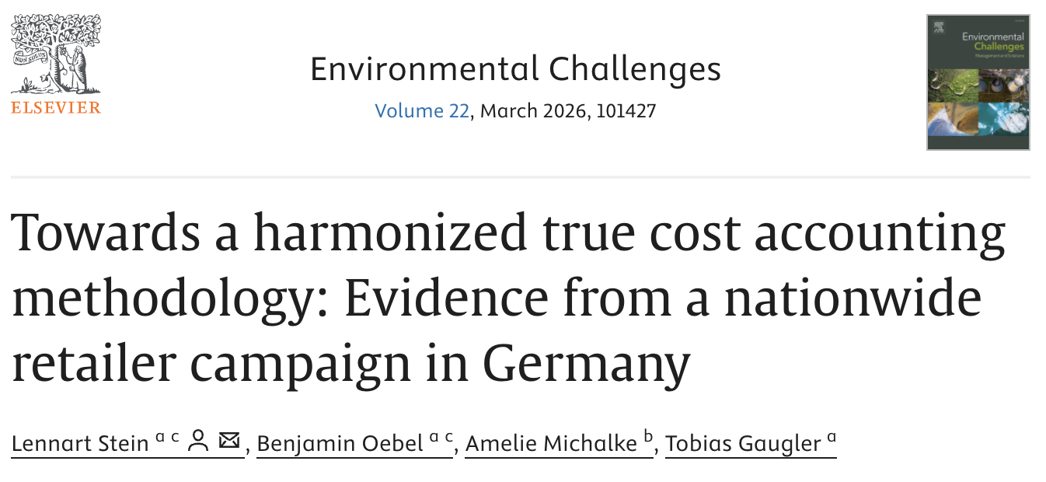
4. TCA in Practice – The Penny Campaign
17
Notes:
Ab 32 min

Slide 29





5. Some of PATOS Projects & Initiatives
  PLAN’EAT Project with TMG
  Diets’ prices Project with Madre Brava
17
Notes:
Ab 32 min

Slide 30
References
Baker, L., Castilleja, G., De Groot Ruiz, A., Jones, A. (2020). Prospects for the true cost accounting of food systems. Nature Food. DOI: 10.1038/s43016-020-00193-6
Baur, N., Blasius, J. (2014). Handbuch Methoden der empirischen Sozialforschung. Springer VS. Wiesbaden, Germany.
Campbell, B. M., Beare, D. J., Bennett, E. M., Hall-Spencer, J. M., Ingram, J. S. I., Jaramillo, F., Ortiz, R., Ramankutty, N., Sayer, J. A., & Shindell, D. (2017). Agriculture production as a major driver of the Earth system exceeding planetary boundaries. Ecology and Society, 22(4). DOI: 10.5751/ES-09595-220408
De Bryun, S., Bijleveld, M., de Graaff, L., Schep, E., Schroten, A., Vergeer, R., Ahdour, S. (2018): Environmental Prices Handbook, EU28 Version. CE Delft. Delft, Netherlands.
Huijbregts, M. A. J., Steinmann, Z., Elshout, P. M. F., Stam, G., Verones, F., Vieira, M. D. M., van Zelm, R. (2017). ReCiPe 2016 v1.1: a harmonized life cycle impact assessment method at midpoint and endpoint level report I: characterization. RIVM Report 2016-0104a. National Institute for Public Health and the Environment RIVM. Bilthoven, The Netherlands.
Helbling, T (2010). Back To Basics: What Are Externalities? International Monetary Fund. IMF eLibrary.
Michalke, A., Gaugler, T., Stoll-Kleemann, S. (2020). Abschlussbericht zum Forschungsprojekt “How much is the dish? – True Cost Accounting von Umweltfolgen und “Wahre Preisschilder” in Deutschland”. Version 4.4, Stand: 15.10.2020.
Michalke, A., Stein, L., Fichtner, R., Gaugler, T., Stoll-Kleemann, S. (2022). True cost accounting in agri-food networks: a German case study on informational campaigning and responsible implementation. Sustainability Science, 17(2269). DOI: 10.1007/s11625-022-01105-2
Michalke, A., Köhler, S., Messmann, L., Thorenz, A., Tuma, A., Gaugler, T. (2023). True Cost Accounting of organic and conventional food production. Accepted in Journal of Cleaner Production.
Ott, W., Baur, M., Kaufmann, Y., Frischknecht, R., Steiner, R. (2006). Assessment of Biodiversity Losses - Monetary Valuation of Biodiversity Losses due to Land Use Changes and Airborne Emissions. Deliverable D.4.2.-RS 1b/WP4 of NEEDS - New Energy Externalities Developments for Sustainability. Econcep AG, ESU-services.
Steffen, W., Richardson, K., Rockström, J., Cornell, S. E., Fetzer, I., Bennett, E. M., Sörlin, S. (2015). Planetary boundaries: Guiding human development on a changing planet. Science, 347(6223). DOI: 10.1126/science.1259855
Sturm, B., Vogt, C. (2011). Environmental Economics: An Application-Oriented Introduction. Umweltökonomik: Eine anwendungsorientierte Einführung. Physica-Verlag Heidelberg. Heidelberg, Germany.
Sutton, M.,; Oenema, O., Erisman, J., Leip, A., van Grinsven, H., Winiwarter, W (2011). Too much of a good thing. Nature (472). DOI: 10.1038/472159

Slide 31
Modelling Parameters from literature

Slide 32
2. TCA Calculation – 2.3 Results
Contribution D
Environmental impact assessment
Organic base case O1 (yield – SD) O3 (manure C)
+
Conventional base case O2 (yield + SD) O4 (manure literature)
300%
Findings
Land use: Little to no benefits due to generally lower organic yields
GWP: strongly affected by yield
Terrestrial ecotoxicity: especially influenced by pesticides
Human non-carginogenic toxicity: highly dependent on manure input
High manure use results in highest impacts
16
Notes:
2. Only midpoint where lowest yield scenario has highest impacts throughout all products; manure scenarios are close together
Woher kommt die Auswahl der Midpoints? → auf Tonspur und dann im Backup
„strong yield effects“ anders formulieren
Legende größer

Slide 33
Midpoint evaluation animal-based

Slide 34
Cost factors with adaptations
Midpoint | unit | E [€] ^{[1]} | E1 [€] ^{[2]} | E2 [€] ^{[3]} | E3[€] ^{[4]}
Climate change | kg CO₂ eq | 0.20 | 0.06 | 0.37 | 0.15
Ozone depletion | kg CFC-11 eq | 30.40 | 22.10 | 45.70 | 31.80
Ionizing radiation | kBq U235 eq | 0.05 | 0.03 | 0.06 | ^{[5]}
Photochemical oxidant formation | kg NMVOC | 1.15 | 0.84 | 1.84 | 2.22
Particulate matter formation | kg PM10 eq | 39.20 | 28.00 | 60.40 | 31.64 ^{[5]}
Terrestrial acidification | kg SO₂ eq | 4.97 | 0.53 | 5.66 | 3.36
Freshwater eutrophication | kg P eq | 1.86 | 0.25 | 2.11 | 304.00
Marine eutrophication | kg N eq | 3.11 | 3.11 | 3.11 | 63.40
Terrestrial ecotoxicity | kg 1,4-DB eq | 8.69 | 1.17 | 9.85 | 7.27
Freshwater ecotoxicity | kg 1,4-DB eq | 0.04 | 0.00 | 0.04 | 0.03
Marine ecotoxicity | kg 1,4-DB eq | 0.01 | 0.00 | 0.01 | 0.01
Human toxicity | kg 1,4-DB eq | 0.10 | 0.07 | 0.15 | 0.038 ^{[6]}
Land occupation | m²a | 0.0845 | 0.0255 | 0.6850 | 0.2390 ^{[7]}
Natural land transformation | m² | ^{[9]} | ^{[9]} | ^{[9]} | 0.0223 ^{[7]}
Metal depletion | kg Fe eq | ^{[9]} | ^{[9]} | ^{[9]} | 0.005 ^{[8]}
Fossil depletion | kg oil eq | ^{[9]} | ^{[9]} | ^{[9]} | 0.437
Water depletion | m³ | ^{[9]} | ^{[9]} | ^{[9]} | 1.27
Table S1-3: Cost factors
[1] E: For global warming the price factor is derived from Umweltbundesamt (2020), for all other midpoints the average values from the Environmental Prices Handbook (EPH) are taken (de Bruyn et al., 2018).
[2] E1: For global warming the price factor is derived from the average values from the EPH, the German consumer price index of the Federal Statistical Office was used for price adjustment from 2015 to 2020 (Statistisches Bundesamt (Destatis), 2021). For all other midpoints the lower bound values from the EPH are taken (de Bruyn et al., 2018).
[3] E2: For global warming the price factor is derived from Ricke et al. (2018), exchange rates of the European Central Bank were used to for currency conversion from USD to EUR (ECB, 2021). For all other midpoints the upper bound values from the EPH are taken (de Bruyn et al., 2018).
[4] E3: All price factors are derived from the True Pricing foundation (Galgani et al., 2020).
[5] The TPF documentation gives a cost factor of €46.20 per kg PM2.5 eq. To convert from PM2.5 to PM10, a characterization factor of 0.68 (de Bruyn et al., 2018) was used.
[6] The TPF documentation gives a cost factor of €54,800 per DALY. To convert from DALY to kg 1,4-DB eq, the ReCiPe 2008 midpoint-to-endpoint factor of 7∙10⁻⁷ was used.
[7] Grassland
[8] The TPF documentation gives a cost factor of €0.223 per kg Cu eq. To convert from Cu to Fe, the ReCiPe 2008 characterization factor of 42.7 kg Fe eq. per kg Cu eq. was used.
[9] No price factor available, which makes the monetized evaluation a conservative estimate.

Slide 35
Limitation of environmental costing
Main limitations
model and data uncertainties
large source material: attempt to standardize assumptions and modelling choices but inconsistencies may occur
average values from average emission source in Europe
Moral dilemma: what is a safe environment worth?
Uncertainties must be openly communicated and results must be discussed against this background

Slide 36
Sensitivity analysis over all scenarios

